Slide 1


CUSTOM HASH
FUNCTION
SimpleHash256
NAGA SRI HARSHA VARDHAN KANAPARTHI

Slide 2

Project Goal
To Implement a cryptographic hash function from scratch without using
any external cryptographic libraries
Key Feature
  256-bit fixed output (64 hex characters)
  Merkle-Damgård construction
  64 rounds of compression per block
  Pure Python implementation

Slide 3
What is Hash Function?

Slide 4
EXAMPLE
┌─────────────────┐
│ Input Data │
│ (Any Size) │
└────────┬────────┘
│
▼
┌─────────────────────────┐
│ SimpleHash256 │
│ Hash Function │
│ │
│ • Merkle-Damgård │
│ • 64 Rounds │
│ • 256-bit Output │
└────────┬────────────────┘
│
▼
┌─────────────────┐
│ 256-bit Hash │
│ (64 hex chars) │
└─────────────────┘

Slide 5
HASH FUNCTION PROPERTIES
DETERMINISTIC
FIXED OUTPUT LENGTH
Same input → Always same output
Always 256 bits regardless of input size
AVALANCHE EFFECT
COLLISION RESISTANCE
Small input change → Large output change (~50% bits flip)
Virtually impossible for two different inputs to produce same hash
ONE-WAY FUNCTION
Cannot reverse hash to find original input
Notes:
"This project implements a 256-bit hash function using the same design principles as SHA-256, but built entirely from scratch to demonstrate deep understanding of cryptographic primitives."

Slide 6
MERKLE-DAMGÅRD CONSTRUCTION
STEP 3: BLOCK PROCESSING
┌─────────────┐ ┌─────────────┐
│ Block 1 │──────▶│Compression │
│ (512 bits) │ │ Function │
└─────────────┘ └──────┬──────┘
│
┌───────▼────────┐
│ Updated State │
│ (256 bits) │
└───────┬────────┘
│
┌─────────────┐ ┌──────▼──────┐
│ Block 2 │──────▶│Compression │
│ (512 bits) │ │ Function │
└─────────────┘ └──────┬──────┘
│
┌───────▼────────┐
│ Updated State │
└───────┬────────┘
│
...
│
▼
STEP 1: INITIALIZATION
┌──────────────────────────────────────┐
│ Initial Hash Values (Constants) │
│ │
│ H₀ = 0x6a09e667 │
│ H₁ = 0xbb67ae85 │
│ H₂ = 0x3c6ef372 │
│ ... (8 values total) │
└──────────────────────────────────────┘
│
▼
STEP 2: MESSAGE PADDING
┌──────────────────────────────────────┐
│ Original Message │
│ "Hello" → 48 65 6C 6C 6F │
└──────────────────────────────────────┘
│
▼
┌──────────────────────────────────────┐
│ Padded Message (512-bit blocks) │
│ [Data][0x80][Zeros][Length] │
└──────────────────────────────────────┘
│
▼
STEP 4: FINAL OUTPUT
┌──────────────────────────────────────┐
│ 256-bit Hash Output │
│ (Concatenate all 8 state values) │
└──────────────────────────────────────┘

Slide 7
CRYPTOGRAPHIC OPERATIONS
Op2: BIT ROTATION
Op1: XOR (Exclusive OR
Spreads changes across all positions
Example: Rotate Right by 7
Before: 10110001 (177)
After: 00000101 (5)
Binary mixing without data loss
Example: 1010 XOR 1100 = 0110
Op3: MODULAR ADDITION
Non-linear transformation
Example: (0xFFFFFFFF + 1) mod 2³² = 0
BENEFITS
  Reversible in isolation but secure when combined
  Different rotation amounts create complex diffusion
  Introduces carries that propagate unpredictably

Slide 8
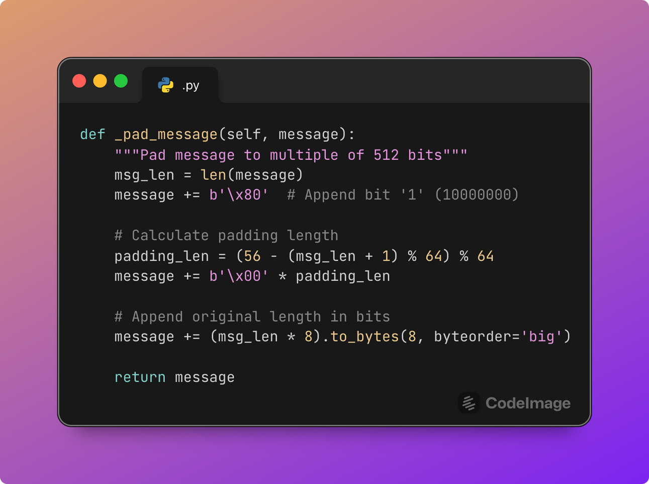
CODE DEEP DIVE - PADDING
Input: "Hello" (5 bytes)
Step 1: Add 0x80
[48 65 6C 6C 6F][80]
Step 2: Add padding to reach 56 bytes
[48 65 6C 6C 6F 80][00 00 00 ... 00] (50 zero bytes)
Step 3: Add length (5 bytes × 8 = 40 bits = 0x28)
[... previous bytes ...][00 00 00 00 00 00 00 28]
Total: 64 bytes (512 bits) ✓

Slide 9
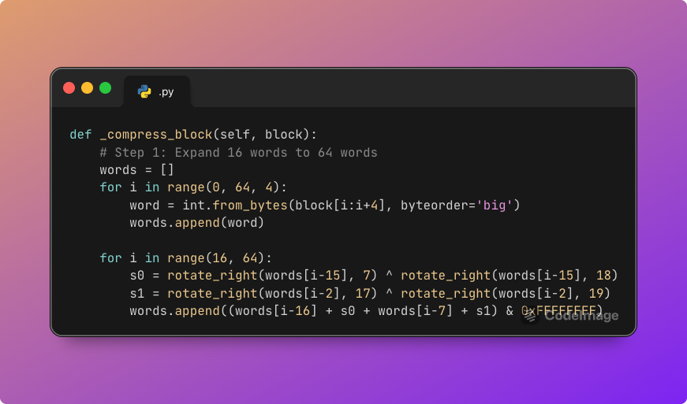
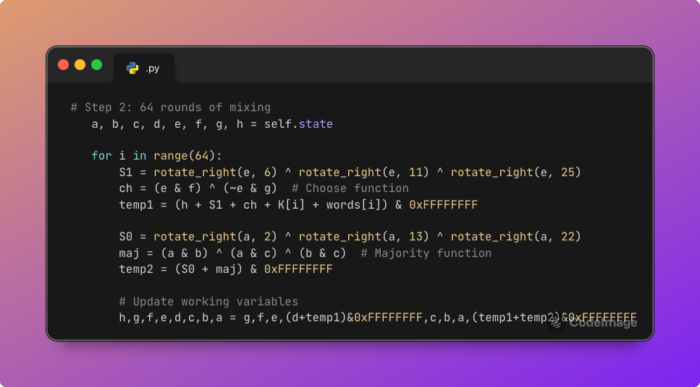
CODE DEEP DIVE - COMPRESSION
Key Functions:
Ch (Choose):
If e=1, use f
If e=0, use g
Maj (Majority):
Output the majority
bit among a, b, c
Σ (Sigma):
Multiple rotations
for diffusion

Slide 10
Achieving the Avalanche Effect
Goal: 1-bit input change → ~50% output bits change
Layer 1: MULTIPLE ROTATIONS
Rotation by: 2, 6, 7, 11, 13, 22, 25 bits
Layer 3: MIXED OPERATIONS
XOR (linear) + Addition (non-linear)
Layer 2: 64 ROUNDS
Single bit propagates through 64 iterations
Round 1: 1 bit changed
Round 5: ~100 bits changed
Round 64: ~128 bits changed
Layer 4: ROUND CONSTANTS
K[i] breaks symmetry
Prevents identical blocks from producing identical results

Slide 11
Achieving the Avalanche Effect
Goal: 1-bit input change → ~50% output bits change
Layer 1: MULTIPLE ROTATIONS
Rotation by: 2, 6, 7, 11, 13, 22, 25 bits
Layer 3: MIXED OPERATIONS
XOR (linear) + Addition (non-linear)
Layer 2: 64 ROUNDS
Single bit propagates through 64 iterations
Round 1: 1 bit changed
Round 5: ~100 bits changed
Round 64: ~128 bits changed
Layer 4: ROUND CONSTANTS
K[i] breaks symmetry
Prevents identical blocks from producing identical results

Slide 12
Testing Results
Test Category | Result
Determinism | PASS
Avalanche Effect | PASS
Collision Resistance | PASS
Fixed Output Length | PASS
Performance | PASS
Special Cases (Unicode) | PASS
Incremental Hashing | PASS

Slide 13
CONCLUSION & LEARNINGS
What I Learned
  Why specific operations (XOR, rotation, addition) are chosen
  How avalanche effect is engineered, not accidental
  The complexity required for cryptographic security
  Why we DON'T roll our own crypto in production
  Importance of standardization and peer review

Slide 14
Thank you

